Slide 1

RUNGTA COLLEGE OF DENTAL SCIENCES & RESEARCH
TITLE OF THE TOPIC: MICROBIOLOGY IN ENDODONTICS
DEPARTMENT OF CONSERVATIVE DENTISTRY AND ENDODONTICS

Slide 2
Specific learning Objectives
At the end of this presentation the learner is expected to know
Core areas* H | Domain ** | Category #
Routes of microorganism, Microrganism associated with root canal infection | Cognitive | Must know
Intraradicular infection, extraradicular infection | Psychomotor | Nice to know
Methods of identification of microbes | Affective | Desire to know
*Subtopic of importance
** Cognitive, Psychomotor or Affective
# Must know , Nice to know & Desire to know

Slide 3
TABLE OF CONTENT:
INTRODUCTION
ROUTES OF MICROORGANISM INGRESS
MICROORGANISMS FOUND IN ROOT CANALS ASSOCIATED WITH ENDODONTIC INFECTIONS
INTRARADICULAR INFECTION
EXTRARADICULAR INFECTION
METHODS FOR IDENTIFICATION OF MICROBES

Slide 4
MOLECULAR BIOLOGY METHODS
Development of MBT has provided vast array of new technique for study of human microbiota.
Identification of previously unknown and uncharacterized human pathogens
Revealed previously unanticipated diversity of human microbiota with as-yet-uncultivated bacteria (>50%)

Slide 5
He Several genes have been chosen as targets for bacterial identification
16S rRNA
23S rRNA
16S-23S rRNA gene internal transcribed sequences
The rpoB gene encoding beta-subunit of RNA polymerase
The groEL gene encoding the heat shock protein
The gyrB gene encoding the beta-subunit of DNA gyrase
Homologous recombination encoding recA

Slide 6
16S rRNA gene/DNA→widely used target→ universally distributed among bacteria
Affords reliability for inferring phylogenetic relationships.
18S rRNA – fungi &other eukaryotes

Slide 7
Plethora of molecular methods
Broad range of PCR followed by cloning and sequencing → to unravel the breadth of microbial diversity in a given environment
Microbial communities can be analyzed via fingerprinting techniques→ denaturing gradiant gel electrophoresis(DGGE) & terminal restriction fragment length polymorphism(T-RFLP)

Slide 8
Fluorescence in situ hybridization (FISH) can measure abundance of target species and provide information on their spatial distribution in tissues
Other app
DNA-DNA hybridization arrays
Species specific PCR
Nested PCR
Multiplex PCR
Quantitative real time PCR

Slide 9
P.C.R AND ITS DERIVATIVES
PCR method is based on the in vitro replication of DNA through repetitive cycles of denaturation, primer annealing and extension steps carried out in automated devices(thermocyclers)
Can detect as few as 10 bacterial cells in sample with potential sensitivity to the one cell level
Culture (nonselective media)– 10⁴ to 10⁵ cells
Selective media – 10³

Slide 10
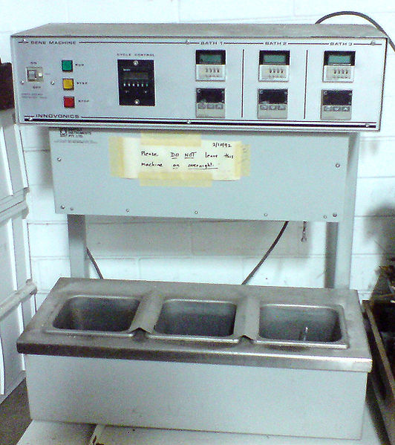
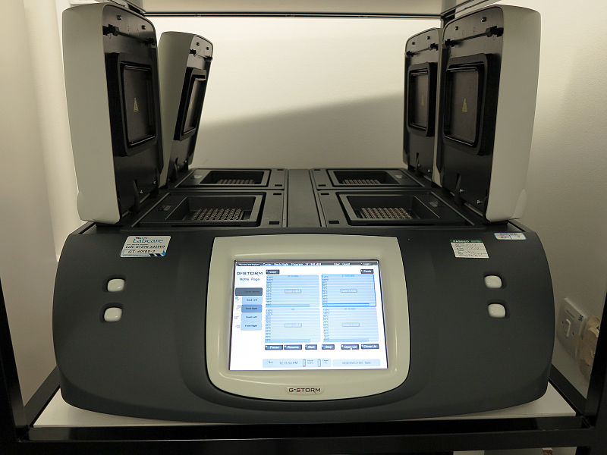
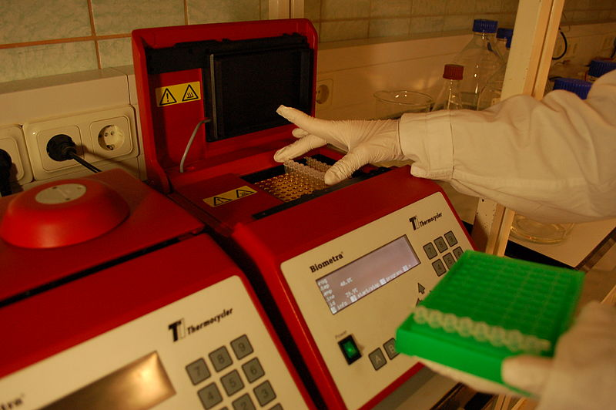

Slide 11
Immunological methods – 10³ to 10⁴ cells
DNA-DNA hybridization – 10² to 10⁴ cells
PCR 10 to 100 times more sensitive

Slide 12
Touchdown PCR
Strategy to increase the specificity of the assay
Useful to avoid the amplification of spurious DNA fragments (non target)

Slide 13
Nested PCR → advised mainly to have increased sensitivity, but also exhibit increase specificity
Multiplex PCR → permits simultaneous detection of different sp in a sample
Reverse transcriptase PCR → developed to amplify RNA targets & to exploit the use of the reverse transcriptase which can synthesize a strand of complementary DNA from RNA template

Slide 14
PCR based microbial timing → for clonal analysis and comparison of microbial isolates through PCR generated fingerprinting profile
Real time PCR :
usually qualitative / semi quantitative
Allows the quantification of the amount of DNA
Allows quantification of individual target sp as well as total bact

Slide 15
Advantages of real time PCR:
rapidity
Identify PCR products directly without the use of agarose gels
Less contamination

Slide 16
Broad range PCR:
used to investigate the breadth of microbial diversity
Can detect the unexpected bacterial diversity
Allows identification of various as-yet-uncultivated bacterial pathogens

Slide 17
Broad range PCR products can be alternatively analyzed by fingerprinting tech
Genetic fingerprinting tech → to determine the structure and diversity
Denaturing gradient gel electrophoresis(DGGE)
Terminal restriction fragement length polymorphism (T-RFLP)

Slide 18
DNA-hybridization
Socransky et al(‘94)
Process of annealing the complementary bases of two single stranded DNA molecules
Employs labeled DNA probes → locate & bind to a target sequence, forming new duplex molecule.
The labelled duplex can then be detected

Slide 19
Probes are segments of single stranded DNA labeled with detection milecules
Constructed from either whole genomic DNA or oligonucleotides
Genomic – more likely to cross react with non target
Oligonucleotide – limited or no cross reactn

Slide 20
DNA microarrays
Schena et al (’95)
Consist of high density matrix of DNA probes, synthesized on glass/silicon slide
Can be used to enhance PCR product detection and identification

Slide 21
FISH (fluorescence in situ hybridization)
Uses fluorescently labeled rRNA probes fluorescence microscopy to detect intact microbial cells
Gives info → presence, morphology, number, organization and spatial distribution
Allows detection of not only cultivated sp but also

Slide 22
ADVANTAGES OF MOLECULAR BIOLOGY TECH:
Detect both cultivated/as-yet-non sp
High specificity
High sensitivity
Rapidity
Do not require carefully controlled anarobic conditions during sampling and transportation
used during antimicrobial treat
Anarobic handling & expertise not required
Samples can be stored frozen for later analysis
Detect dead m.org

Slide 23
Limitations of MBT:
Qualitative/semi quantitative (exp; real time PCR, microarray)
Detect only 1 sp or few diff sp at a time (broad range,microarray)
Detect only target sp & fails to detect unexpected sp (broad range)
Some – laborious & costly
Hybridization- detect only cultivable sp

Slide 24
Teaching Materials
Endodontic practices - Grossman
Pathways of pulp – Cohen
Textbook of Endodontics – Nisha Garg
Endodontics - Ingle

Slide 25
TAKE HOME MESSEGE/ FOR THE TOPIC COVERED (SUMMARY)
Infection of the root canal is not a random event.
The type and mix of the microbial flora develop in response to the surrounding environment. Microorganisms that establish in the untreated root canal experience an environment of nutritional diversity.
In contrast, well-filled root canal offers the microbial flora a small, dry, nutritionally limited space.
Thus, we should obtain a better understanding of the characteristics and properties of bacteria and their biofilms along with the environmental changes, to enhance success.

Slide 26
Question & Answer Session
DESCRIBE MOLECULAR BIOLOGY METHODS OF DETECTION OF MICRORGANISM

Slide 27
REFERENCES
Endodontic practices - Grossman
Pathways of pulp – Cohen
Textbook of Endodontics – Nisha Garg
Endodontics - Ingle

Slide 28
THANK YOU

